Slide 1
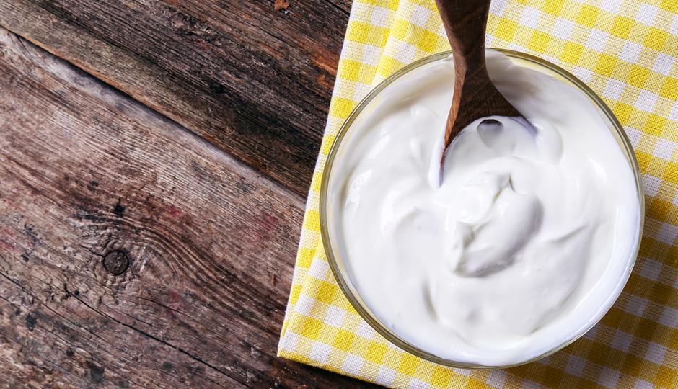
Greek Yogurt Case
Team 15
Wanyu Cheng
Yuying He
Yi Huang
Tianyao Liu
Jing Zou
Feb. 2nd, 2020

Slide 2
Key Findings & Recommendations
Six existing flavors are more successful in Greek yogurt category than regular one because of higher market share (70.30% vs. 43.53%)
Six existing flavors may not be the best mix. Because it does not comply with customer preferences.
Preference and reach are two distinct decision criterias. Pineapple should be launched as a new flavor to increase reach, which is not consistent as suggested by customer preference survey question (raspberry).
The findings and recommendations may not be reliable, as a result of the inappropriate survey question setting up (question 12).
Notes:
jing

Slide 3
Decision-Oriented Analysis Methodology
Analytics Needs and Goals
Market Sales Data:
market segment shares
using descriptive analysis
Decision Criteria:
Which flavors get highest reach
Consumer Survey Data :
consumer preferences
using descriptive and predictive analysis (TURF)
Notes:
Jing

Slide 4
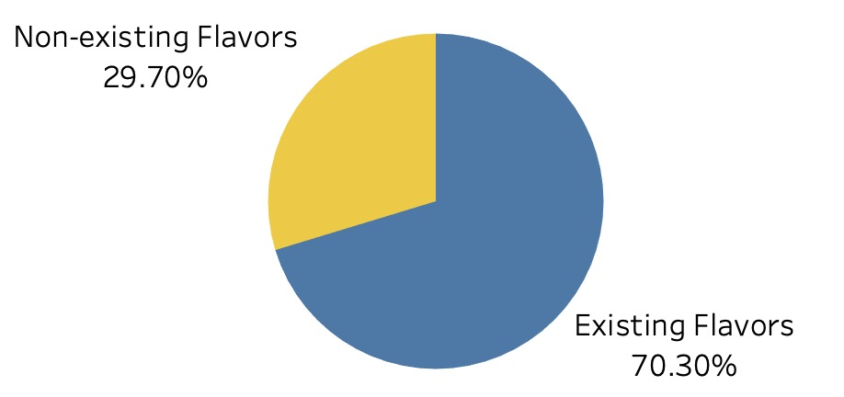
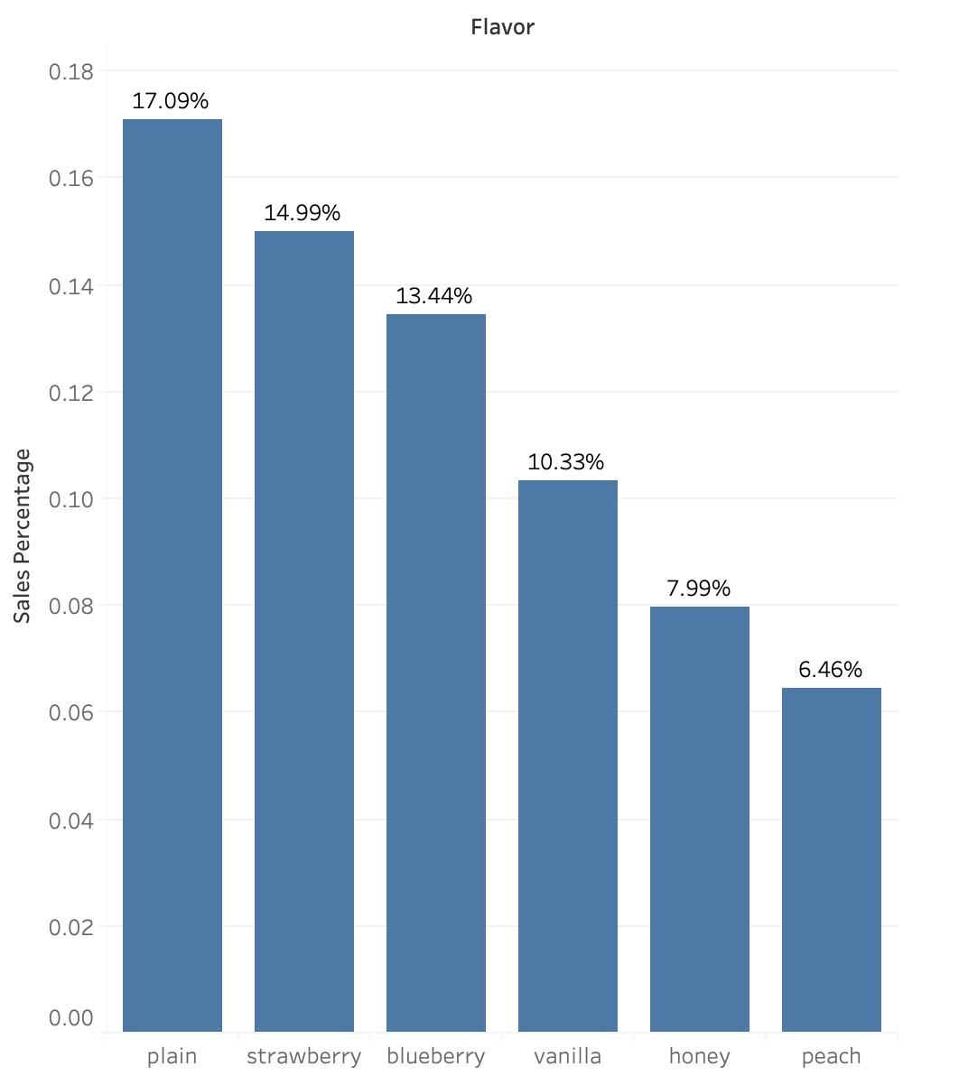
Market Share of Existing Flavors - Greek Segment
70.30% - Percentage of sales of existing flavors in Greek category represents potential for new flavors
Three Top-Selling Flavors: Plain - 17.09%, Strawberry - 14.99, and Blueberry - 13.44%
Least Welcomed Flavor: Peach - 6.46%
Notes:
Wanyu

Slide 5
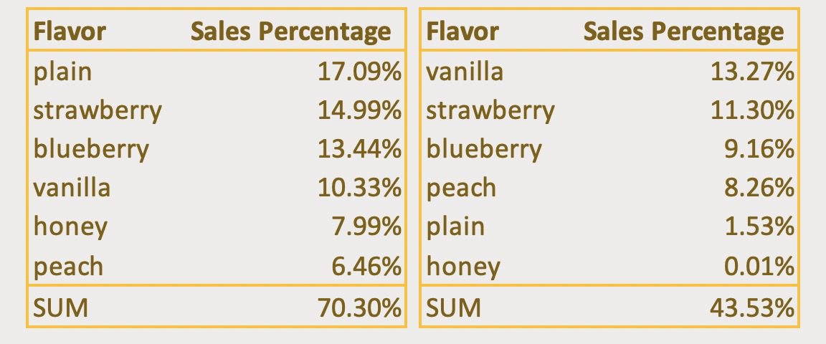
Market Share of Existing Flavors - Whole Segment
GREEK
REGULAR
Six existing flavors are more successful in Greek yogurt category than regular because of higher market share (70.30% vs. 43.53%)
Flavors ranking are different in Greek and regular segment (plain - 1 in Greek vs. 5 in regular; vanilla - 4 in Greek vs. 1 in regular). This indicates that firms should use different flavor mix for different market segments.
Notes:
plain/ vanilla: big difference
Honey: not a well performing flavor in both categories
Yuying

Slide 6
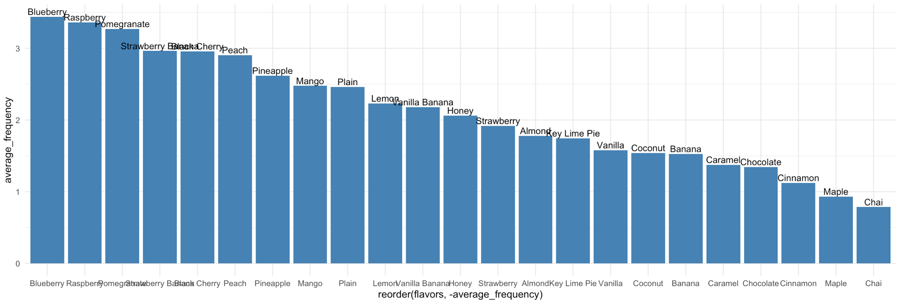
Survey Respondents’ Preferences for Greek Yogurt
Data cleaning:
- Drop rows with NAs to improve further accuracy.
- Weight regular, occasionally and never as frequencies 5, 2, 0
Finding:
- Top 6 preferred flavors are blueberry, raspberry, pomegranate, strawberry banana, black cherry and peach.
- Only blueberry and peach are among existing flavors.
1
2
Calculate sum of each column and divided by nrow() to estimate per person average
3
Use ggplot() to plot the sorted per person consumptions
Notes:
YH

Slide 7
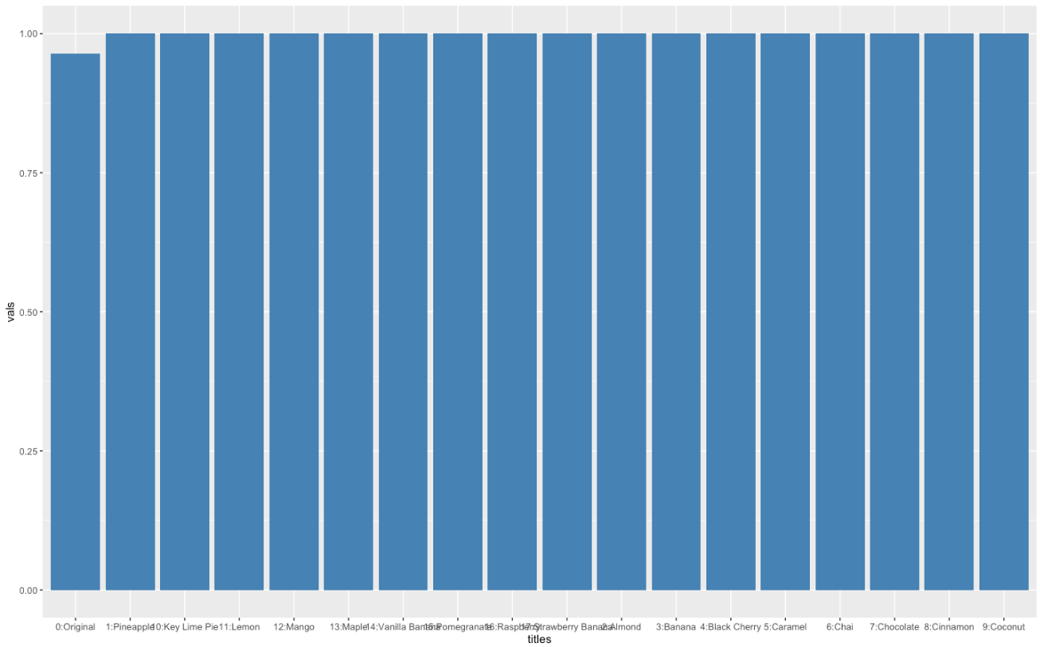
Flavors to be Launched in Future Prediction
Transform the original frequency data into dummy variables (treat regularly and occasionally as ‘would buy’ and assign it as 1; treat never as ‘would not buy’ and assign it as 0.)
Finding:
- The private label should launch pineapple as the new flavor, which leads to biggest incremental reach
Notes:
tianyao

Slide 8
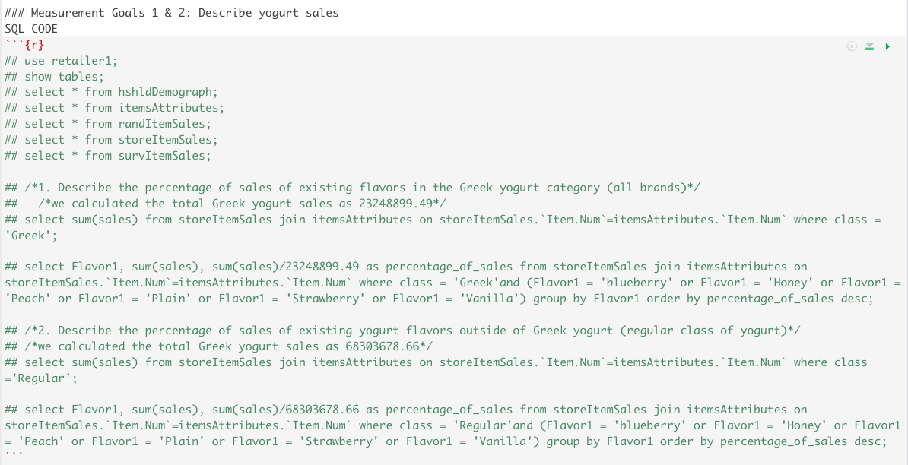
Appendix - OUTPUT FOR SLIDE 4 & 5

Slide 9
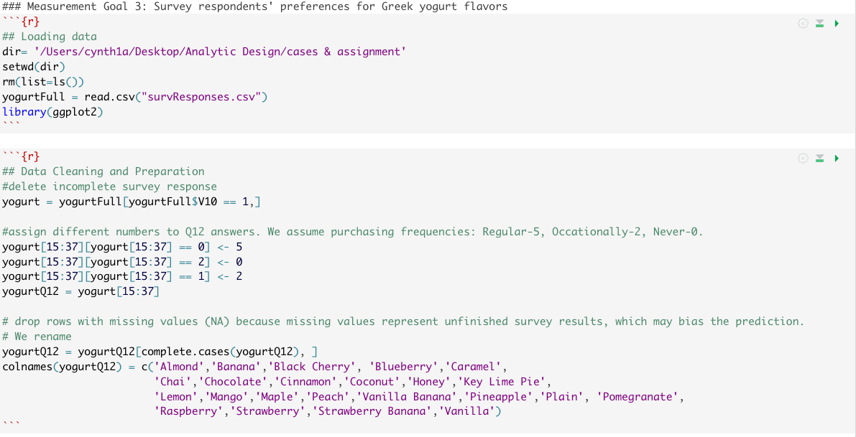
Appendix - OUTPUT FOR SLIDE 6

Slide 10
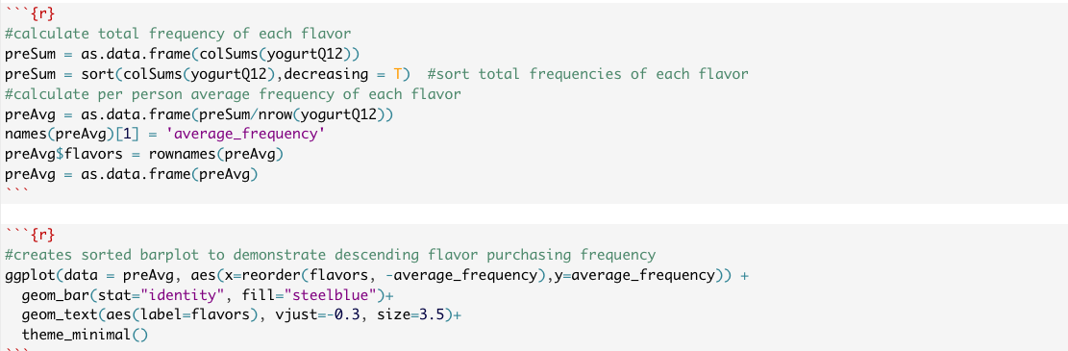
Appendix - OUTPUT FOR SLIDE 6 CONTINUED

Slide 11
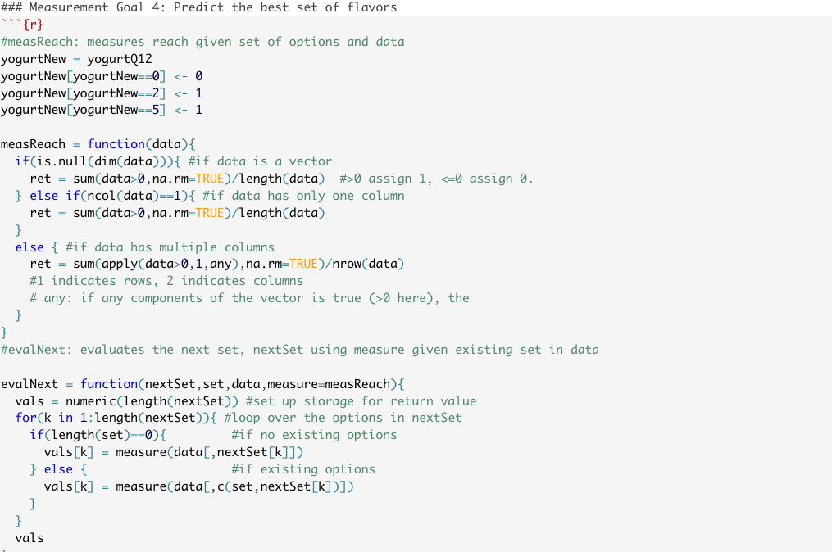
Appendix - OUTPUT FOR SLIDE 7

Slide 12
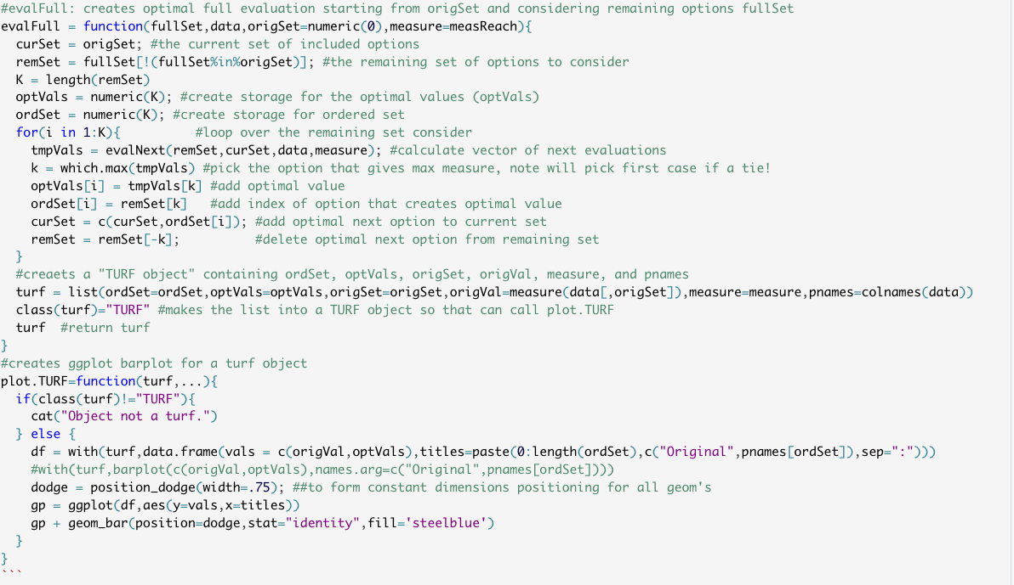
Appendix - OUTPUT FOR SLIDE 7 CONTINUED

